Slide 1

BVRIT HYDERABAD College of Engineering for Women Department of Computer Science & Engineering 06-05-2023
Fire and Smoke Detection
Using Convolutional Neural Networks
Under the Guidance of:
Name: Mr. S. Ashok
Designation: Assistant Professor
Team No: A7
Ms. Y. Varshitha - 19WH1A0556
Ms. V. Kavya - 20WH5A0503

Slide 2
AGENDA
Introduction
Existing system
Problem statement
Literature Survey
Proposed system
Tools and Technology
Architecture
Methodology
Feasibility study
Societal impact
Implementation
Result
References

Slide 3
INTRODUCTION
Fire detection is crucial task for the safety of people.
There are latest developments in deep learning offer a viable solution to process the camera images and detect the presence of wildfire/smoke using convolutional neural networks (CNNs).

Slide 4
EXISTING SYSTEM
An image fire detection algorithm based on support vector machine, Artificial Neural Network.
Heat detectors are generally slower to detect fires.
Heat detectors cannot detect smolder fires which is leading cause of death in such accidents.

Slide 5
PROBLEM STATEMENT
Apply deep learning algorithms to detect wild fire and smoke, which aims to achieve high detection rate.

Slide 6
LITERATURE SURVEY
S.No | Title of the paper | Author(s) & Journal Details | Description/ Interpretation
1 | Research on Image Fire Detection Based on Support Vector Machine | KeChen,Yanying Cheng, HuiBai, Chunjie Mou, Yuchun Zhang, 06 April 2020. Dataset:1500images including 1000 positive samples and 500 negative samples | It avoid the disadvantage of artificially setting the threshold of flame characteristics and have better accuracy than the typical flame detection algorithm.
2 | Wildfire Flame and Smoke Detection Using Static Image Features and Artificial Neural Network | F M Anim Hossain , Youmin Zhang, Chi Yuan, and Chun-Yi Su, 30 September 2019. Dataset:containing images of different scenarios Each of the 240×320 resolution images has 300 16×16 blocks. Therefore, a total of 6,000 blocks were used to train the images using backpropagation. | A novel algorithm that uses a single neural network with multi-class detection ability to detect flame and smoke. The average accuracy of the system is 84.8%.
3 | A Real-Time Smoke Detection Model Based on YOLO-SMOKE Algorithm | Weibin Cai, Cuiyu Wang, Hongan Huang, Tongzhen Wang 11 March 2021 Dataset:3526 pictures that contains thousands of different scenes | YOLO-SMOKE model which shows strong robustness and high accuracy,uses data augmentation to avoid model overfittings.

Slide 7
PROPOSED SYSTEM
According to the principle of object detection algorithms, the flow of image fire detection algorithms based on CNN is used to get better accuracy.
CNN has functions of region proposals, feature extraction and classification.
Firstly, The CNN takes an image as input and outputs region proposals by convolution, pooling, etc.
Secondly, the region-based object detection CNN decides the presence or absence of fire in proposal regions through convolutional layers, pooling layers, fully-connected layers, etc.

Slide 8
TOOLS AND TECHNOLOGIES
ENVIRONMENT | SPECIFICATIONS
Hardware | Processor – Intel core I5 Memory(RAM) – 8GB Storage – 1 TB.
Software | Jupyter notebook
Dataset | Common Kaggle dataset.

Slide 9
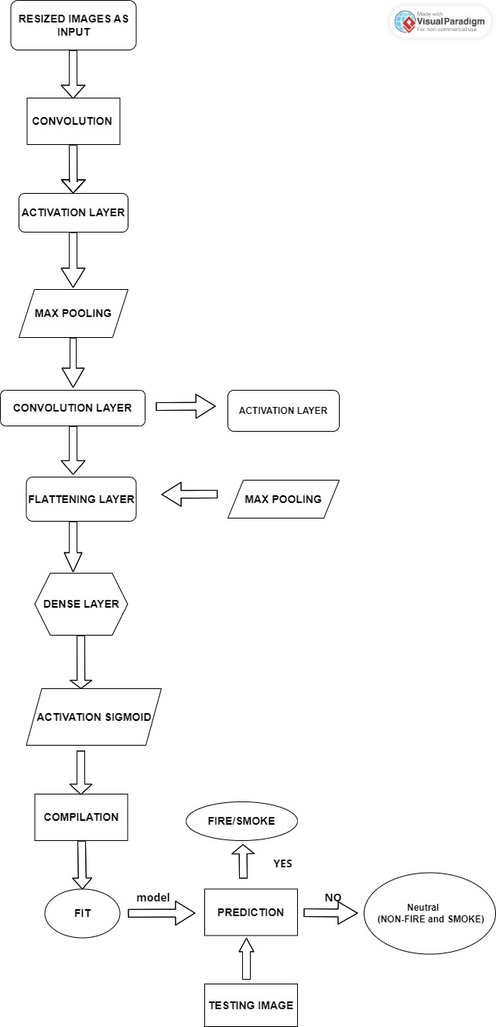





ARCHITECTURE

Slide 10
METHODOLOGY
Convolutional Neural Networks
Dataset: https://www.kaggle.com/datasets/dataclusterlabs/fire-and-smoke-dataset

Slide 11
Feasibility Study
It would be an advantage to develop a image-based fire detection system, which could use these existing surveillance cameras without spending any extra cost.
The cost of using this type of detection is cheaper.
Fire detection system responds faster compared to any other traditional detection methods.

Slide 12
SOCIETAL IMPACT
To prevent damages caused by fire, several fire detection systems were developed.
Early fire detection is crucial and plays a very important role in protecting and saving lives and properties.
Having a fire detection system can significantly reduce damages.

Slide 13
IMPLEMENTATION
Splitting the data into Training set and Testing set
Using CNN Model
Preprocessing the test data
Confusion Matrix
Predicting

Slide 14
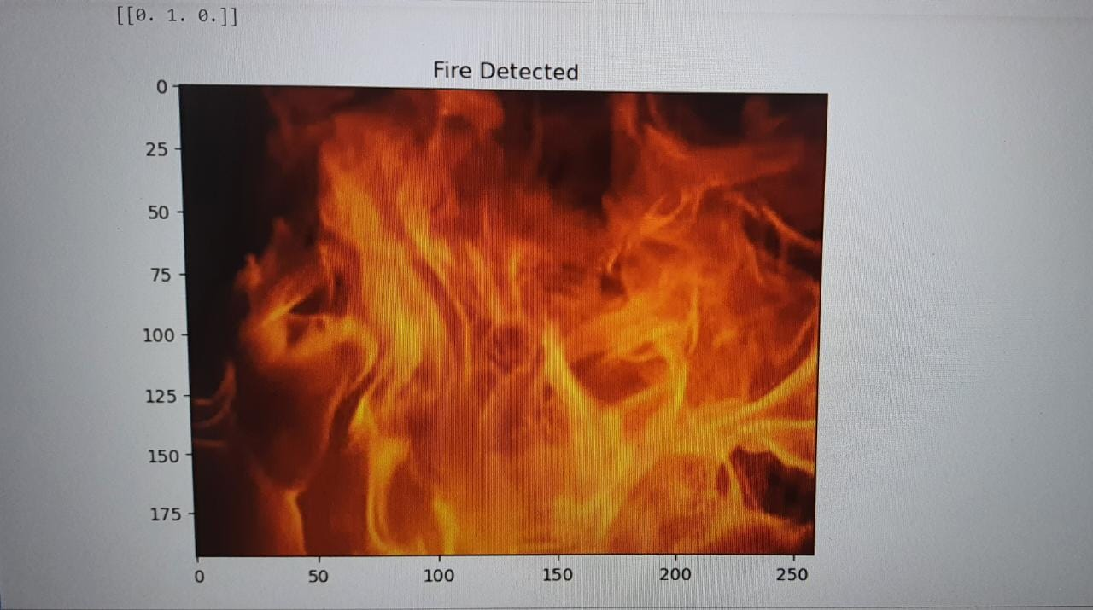
RESULT
FIRE DETECTION:

Slide 15
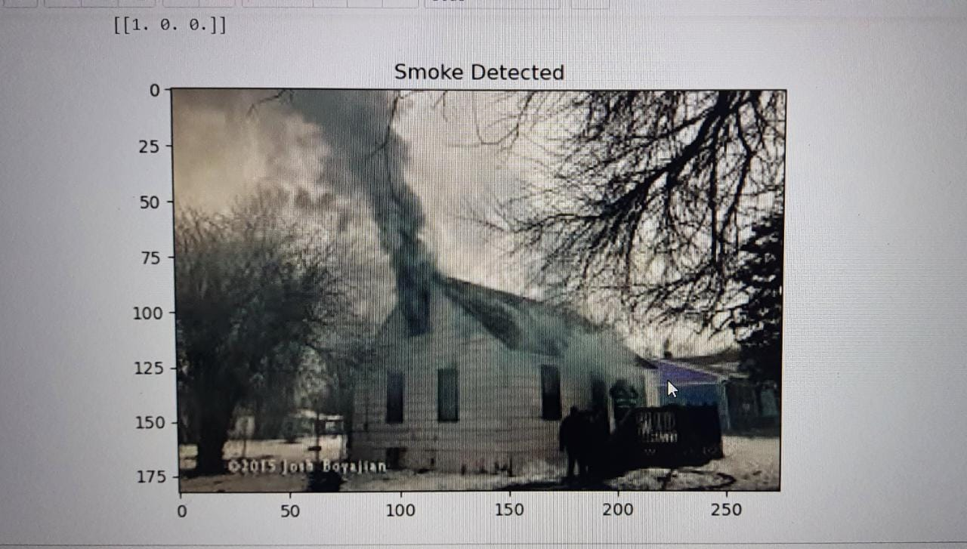
Smoke detection:

Slide 16
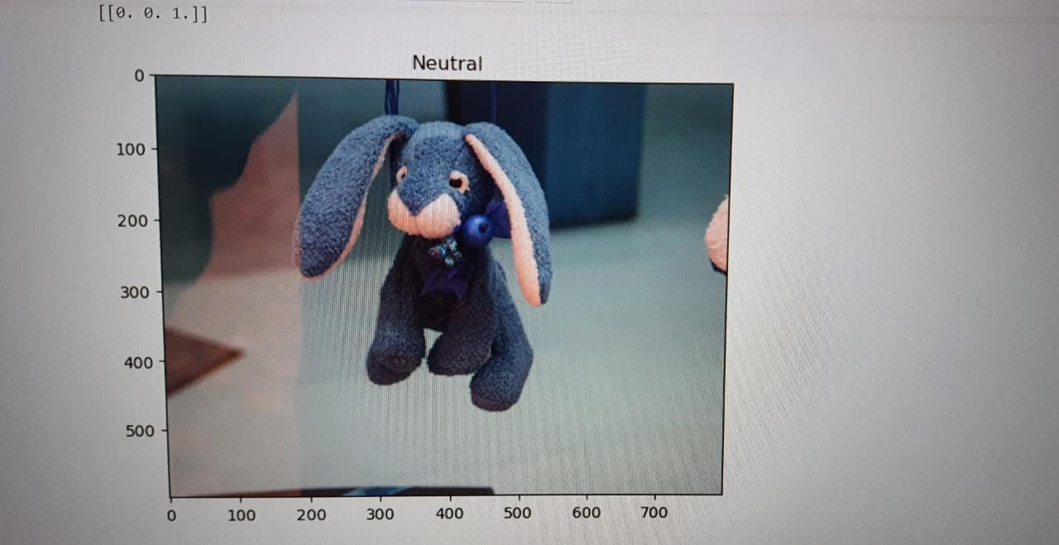
Neutral detection

Slide 17
REFERENCES
[1]KeChen,Yanying Cheng, HuiBai, Chunjie Mou, Yuchun Zhang, “Research on Image Fire Detection Based on Support Vector Machine”, 06 April 2020.
[2]F M Anim Hossain , Youmin Zhang, Chi Yuan, and Chun-Yi Su, “Wildfire Flame and Smoke Detection Using Static Image Features and Artificial Neural Network”, 30 September 2019.
[3] Weibin Cai, Cuiyu Wang, Hongan Huang, Tongzhen Wang,
“A Real-Time Smoke Detection Model Based on YOLO-SMOKE Algorithm”, 11 March 2021

Slide 18
THANK YOU

